Slide 2
Minor Project – I Identifying and promoting various traditional endangered cuisines of different states using Data Analysis
MEMBER’S NAME | ROLL NUMBER | SAP ID | BRANCH
Saumya Sinha | R103219015 | 500076037 | CSE-BAO
Divyanshu Chopra | R103219005 | 500075316 | CSE-BAO
Shashwat Mishra | R103219017 | 500075273 | CSE-BAO
Tarun Kumar | R103219031 | 500078207 | CSE-BAO
Under the guidance of
Dr. Piyush Chauhan

Slide 3
INTRODUCTION
PURPOSE OF THE PROJECT
The main purpose of the project is to build a mathematical model which will help to identify and promote various traditional cuisines of different states (Haryana, Bihar, Himachal Pradesh, Madhya Pradesh) using Data Analytics.
TARGET BENEFICIARY
The main project beneficiaries/target group who will benefit the most from our project will be tourists, local cuisine restaurants, various government and private tourism resorts, traditional entertainment and activity centre and people searching for a more innovative idea to start a restaurant business in near future.
The project will also provide a sense of awareness among people of different states to take more interest in their traditional cuisines.
The project will help local vendors’ recipes of the cuisines which are with them with ages which will get the recognition and can be perceived by the tourists.

Slide 4
MOTIVATION
The implications of this project can be useful for promoting traditional cuisines of different states and for presenting traditional cuisines in a sustainable manner, which will ultimately lead to the preservation of traditional culture and the promotion of a particular state's rich heritage.
Ethnic cuisines are delicacies derived from an ethnic group's tradition and culture, prepared with their understanding of local resources. Traditional foods have become an essential or key motivator in the decisions of tourists.
Food tourism is a subcategory of cultural tourism in that it provides visitors and tourists with the opportunity to learn about a previously unknown or exceptionally distinct culture through an experience. Furthermore, it is highly intriguing for foreigners to learn about various cultures and traditions by tasting the food of other countries and inquiring about their cuisine style and traditional food recipes.

Slide 5
PROBLEM STATEMENT
Traditional foods are nutrient-rich and have a long history of supporting health and wellness. Also, traditional ingredients and raw materials actually can boost the health, medicinal, and nutraceutical values of traditional foods. Moreover it bears the stamp of the phases of its rich history.
So, it is important to identify various traditional cuisine of different states and promote it in restaurants as it is replaced by international fast foods. Also, Food becomes an important or primary motivational factor in tourists’ decision making.
Food tourism can be considered as a subset of cultural tourism and to learn through an experience about a previously unknown or very specific culture and environment. Therefore, one contribution of food is to provide tourists a greater experience. Also, It is very interesting for the foreigners to learn about other culture and tradition. By eating other country’s food and asking about their cuisine style and their traditional food recipes.
Therefore, the implications of this project can be useful for promoting traditional cuisines of different states and providing to transmit traditional cuisines sustainably.

Slide 6
OBJECTIVE
We are collecting data from multiple sources like recipe videos from YouTube, a questionnaire (Google Form Survey) circulated among family and friends and storing it in CSV format for 4 different Indian states – Haryana, Bihar, Madhya Pradesh, Himachal Pradesh.
In questionnaire, we are asking users to select a cuisine in which they are interested. Then, we will analyze the data obtained from the survey form and YouTube data extracted from videos with high view count and form a Linear Regression equation and check the goodness of fit using R-Squared/Adjusted R-Squared Algorithm.
Using this information, we are creating a detailed mathematical model about various parameters which can help us to identify the popularity of various cuisines.
Using this detailed mathematical model, we can extract some insights whether the popularity of a cuisine is affected by various other factors. This will help a lot to identify if there is any dish from a cuisine on the verge of extinction.

Slide 7
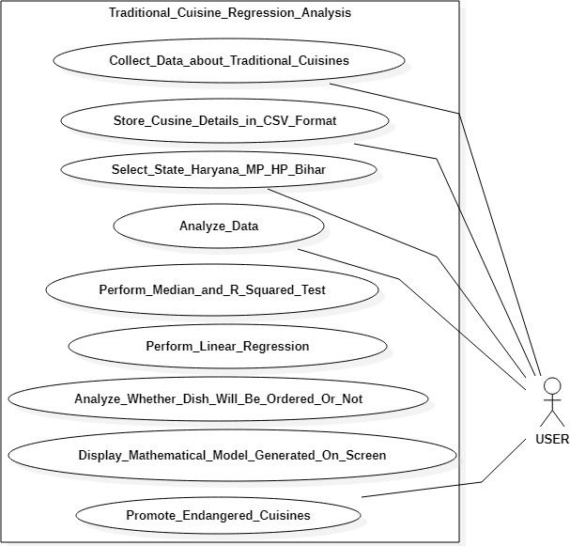
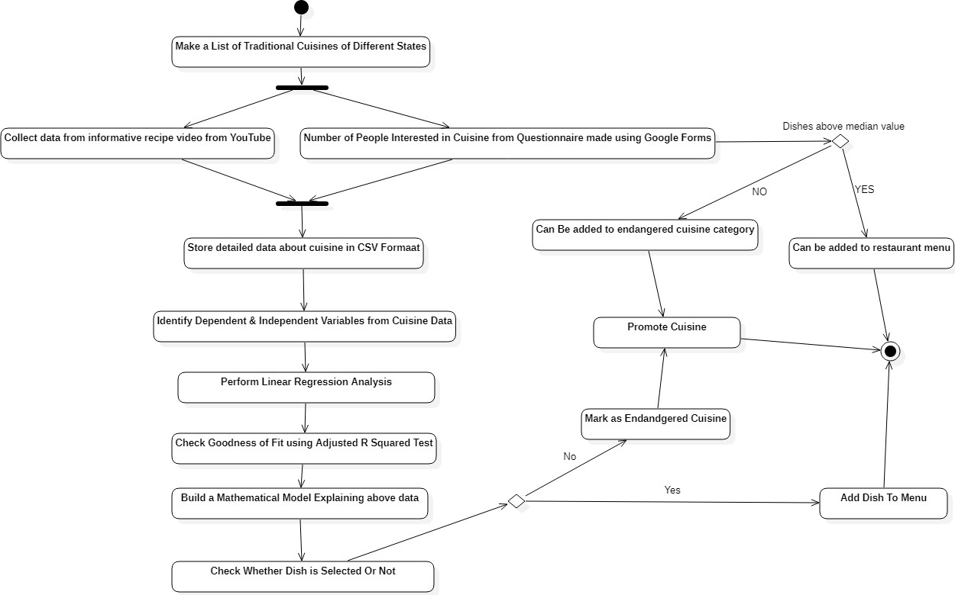
UML diagram

Slide 8
METHODOLOGY
We are forming a Linear Regression mathematical model for our dataset which will help us to find a relationship between various variables used in our traditional cuisines data of Haryana, Bihar, Madhya Pradesh and Bihar State. We will form the equation in such a way that the Y = Dependent Variable (No. of Person/Tourist interested in a particular dish) and X1, X2, X3, … = Independent Variables (Popularity of Dish from Survey Result / Views / Likes / Subscribers from the recipe YouTube video of cuisine).
R-Squared indicates how well the data will fit the regression model (Goodness of a Fit). Adjusted R-Squared is a version of R-squared that has been modified to account for the number of predictors in the model.
Using P-Value we are measuring the likelihood of a dish to get ordered in a particular state’s cuisine. The statistical significance of the observed difference increases as the p-value decreases.

Slide 9
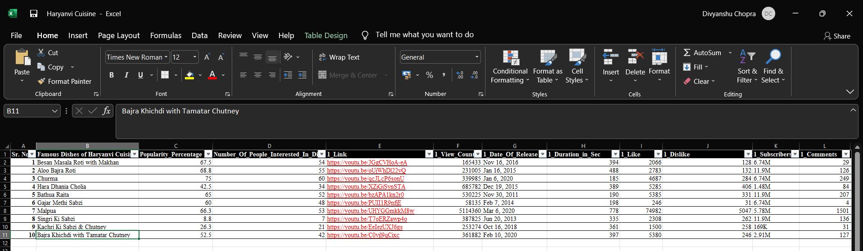
DATA
We have collected our data through two sources-
By YouTube, as shown above from column E-L, collecting fields like likes, dislikes, subscribers, comments, view count, time duration of the video, date of release for the video.
By google forms, given in column C and D, using the answers to our questionnaire about cuisines of our respective 4 states.

Slide 10
Algorithm
Linear Regression Code Algorithm
START
Load & Import Apache Commons Math Library for Simple Linear Regression.
Add the data collected using various youtube videos and google survey to JAVA program for Haryana, Himachal Pradesh, Madhya Pradesh, Bihar.
Create a mathematical model using various Methods.
→ addData()Adds the observations represented by the elements in data.
getIntercept()Returns the intercept of the estimated regression line.
getN()Returns the number of observations that have been added to the model.
getSlopeConfidenceInterval()Returns the half-width of a 95% confidence interval for the slope estimate.
getRSquare()Returns the coefficient of determination, usually denoted r-squared.
5. Print Model
6. END

Slide 11
import org.apache.commons.math3.stat.regression.SimpleRegression; import java.text.NumberFormat; public class LinearRegressionCuisine { public static void main(String[] args) throws Exception { SimpleRegression HP = new SimpleRegression(); System.out.println("##### (Himachal Pradesh) Model - 1 : X = No. Of People Interested & Y = View Count ##### "); HP.addData( 39, 4699 ); HP.addData( 25, 29500 ); HP.addData( 65, 5113503); HP.addData( 15, 6557); HP.addData( 13, 14663); HP.addData( 43, 3224); HP.addData( 25, 2758337); HP.addData( 53, 592337); HP.addData( 74, 14577407); HP.addData( 14, 1998); NumberFormat format = NumberFormat.getInstance(); System.out.println( "### INTERCEPT : " + format.format(HP.getIntercept())); System.out.println( "### N: " + HP.getN()); System.out.println( "### SLOPE: " + format.format( HP.getSlope())); System.out.println( "### SLOPE CONFIDENCE: " + format.format( HP.getSlopeConfidenceInterval())); System.out.println( "### R-SQUARED: " + format.format( HP.getRSquare())); SimpleRegression HP1 = new SimpleRegression(); System.out.println("\n##### (Himachal Pradesh) Model - 2 : X = No. Of People Interested & Y = No. Of Likes ##### "); HP1.addData( 39, 1572); HP1.addData( 25, 1080); HP1.addData( 65, 76717); HP1.addData( 15, 53 ); HP1.addData( 13, 246); HP1.addData( 43, 61 ); HP1.addData( 25, 21736); HP1.addData( 53, 10628 ); HP1.addData( 74, 176702 ); HP1.addData( 14, 916 ); System.out.println( "### INTERCEPT: " + format.format( HP1.getIntercept() ) ); System.out.println( "### N: " + HP1.getN() ); System.out.println( "### SLOPE: " + format.format( HP1.getSlope() ) ); System.out.println( "### SLOPE INTERCEPT: " + format.format( HP1.getSlopeConfidenceInterval() ) ); System.out.println( "### R-SQUARED: " + format.format(HP1.getRSquare())); } }

Slide 12
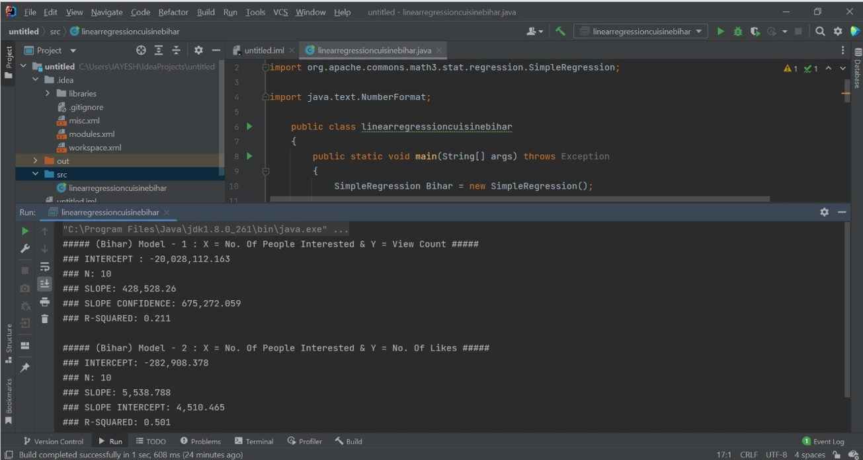

Slide 13
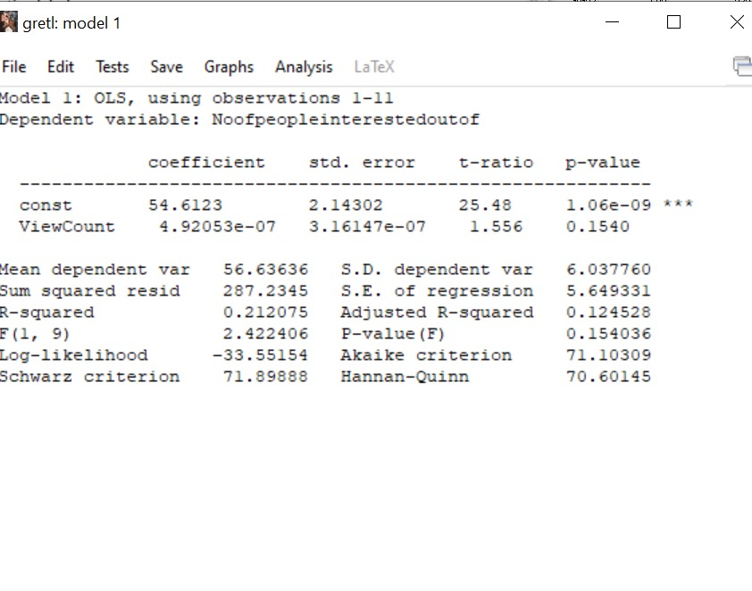
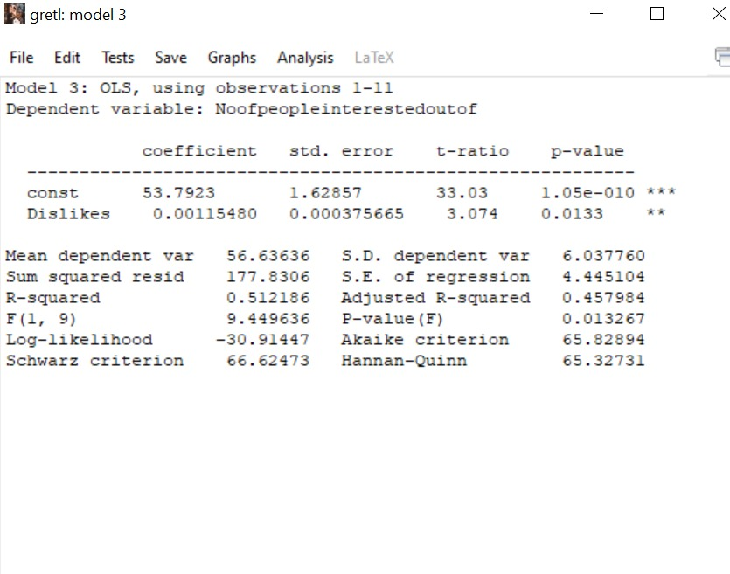
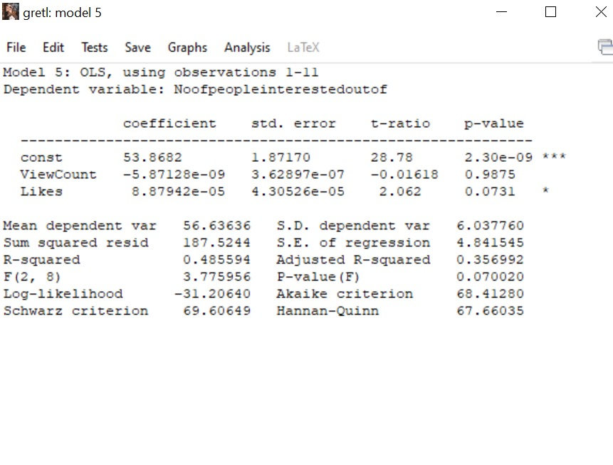
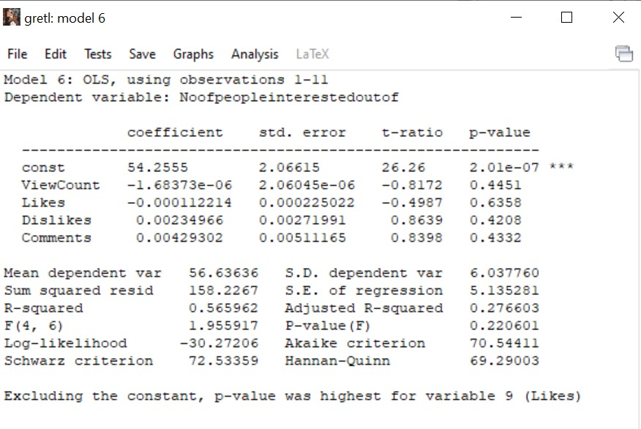
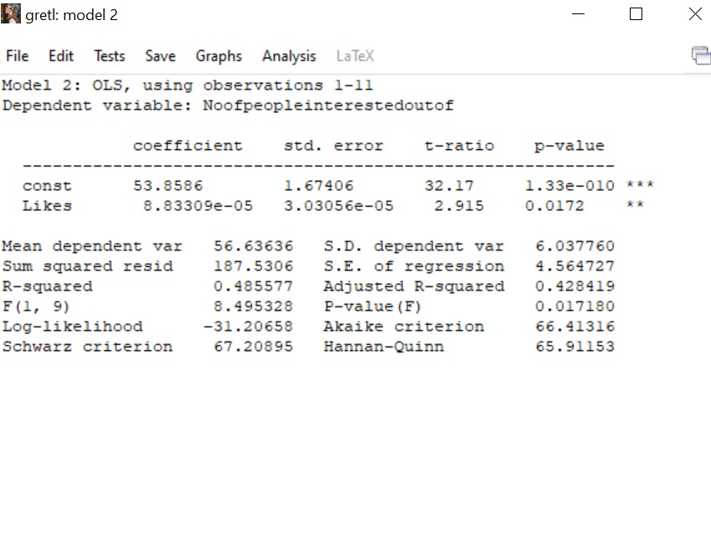
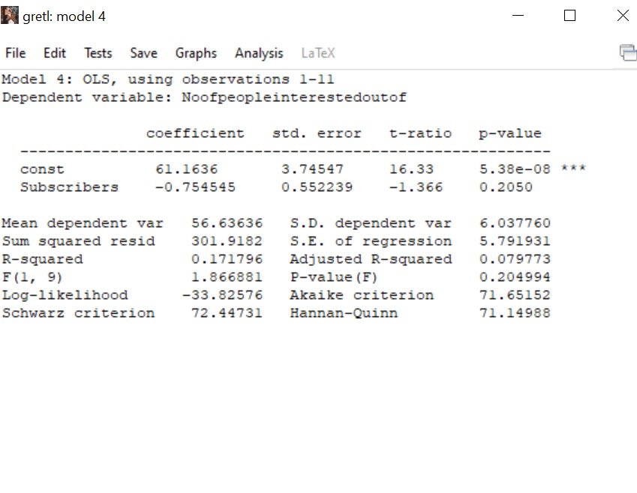
RESULT & DISCUSSION
Cuisine Of Bihar

Slide 14
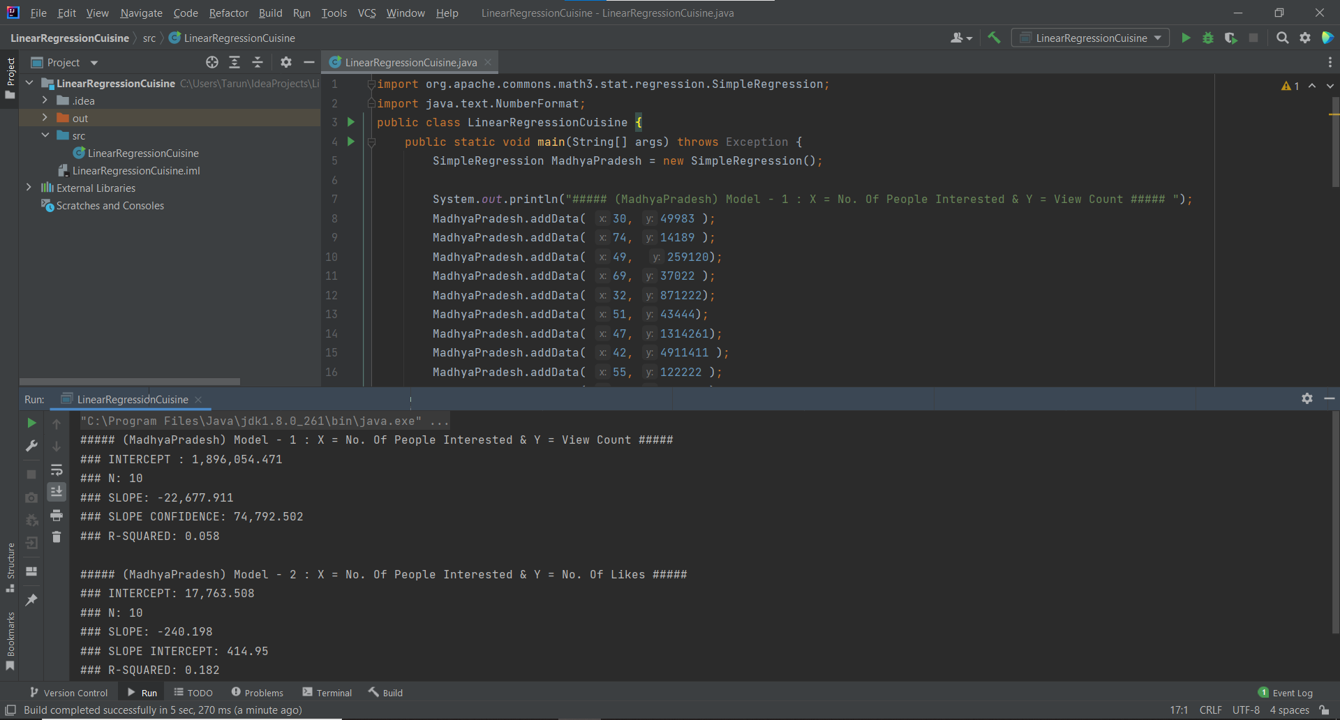

Slide 15
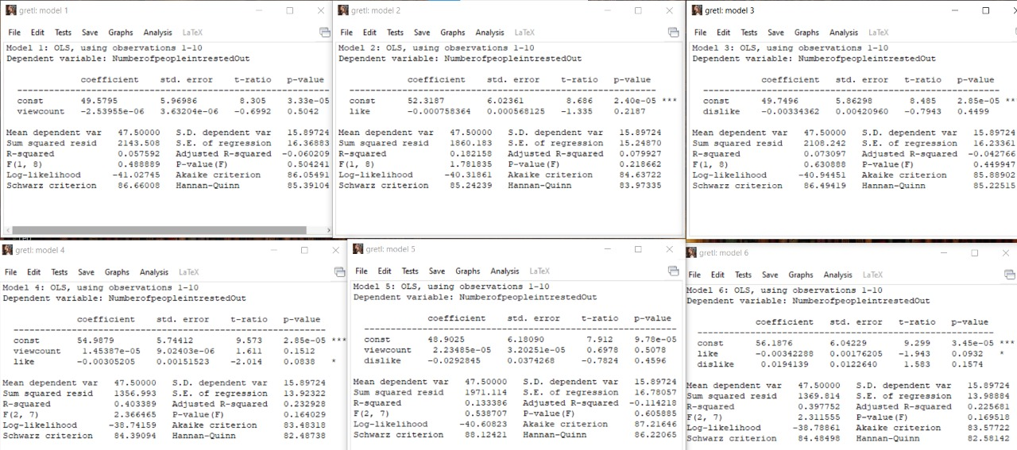
RESULT & DISCUSSION
Cuisine Of Madhya Pradesh

Slide 16
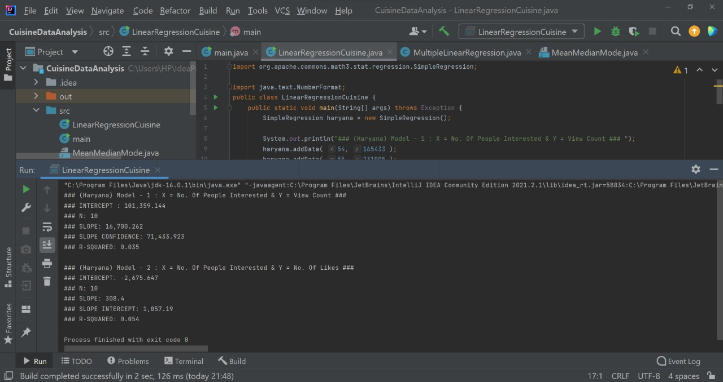

Slide 17
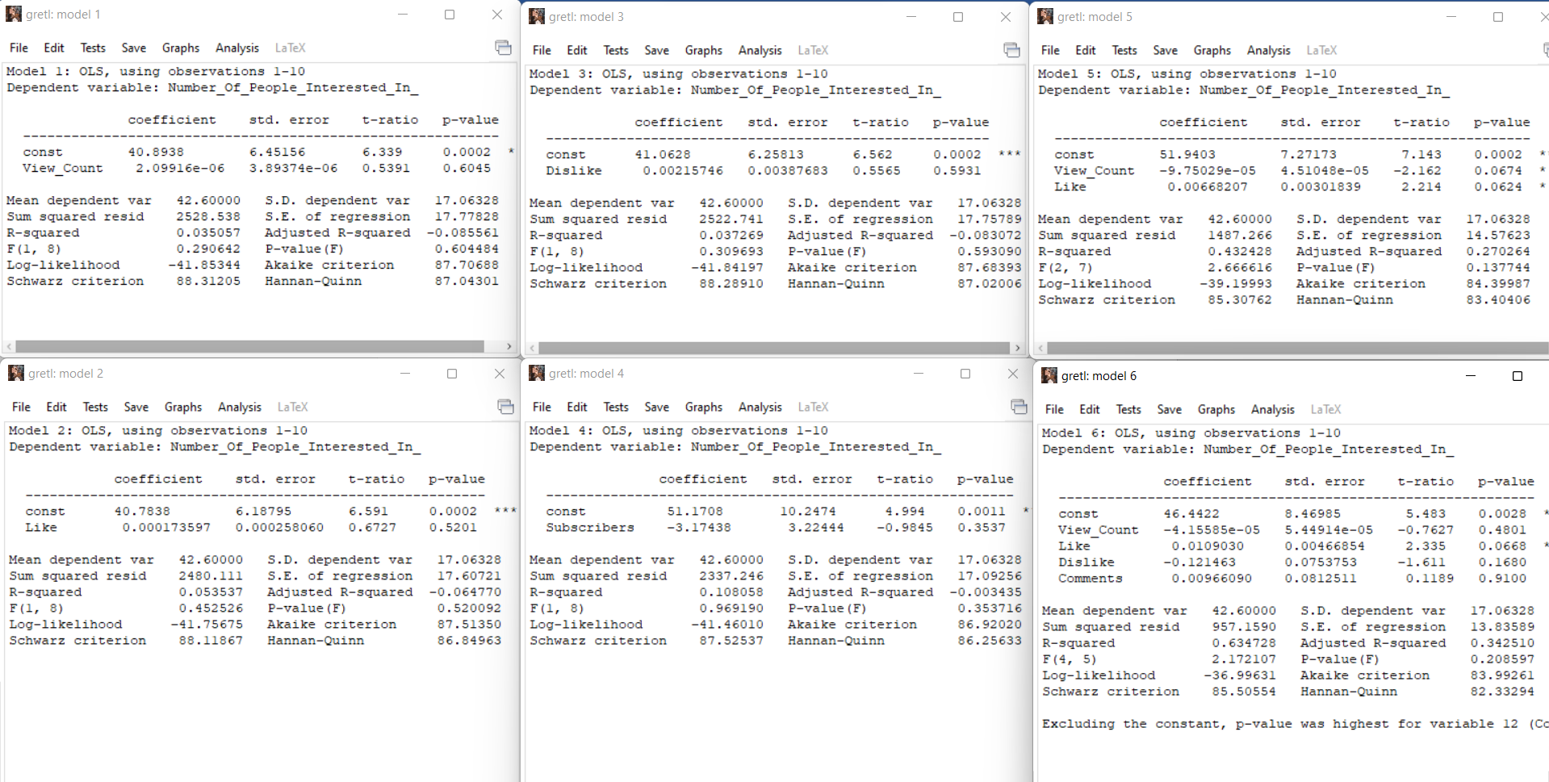
RESULT & DISCUSSION
Cuisine Of Haryana

Slide 18
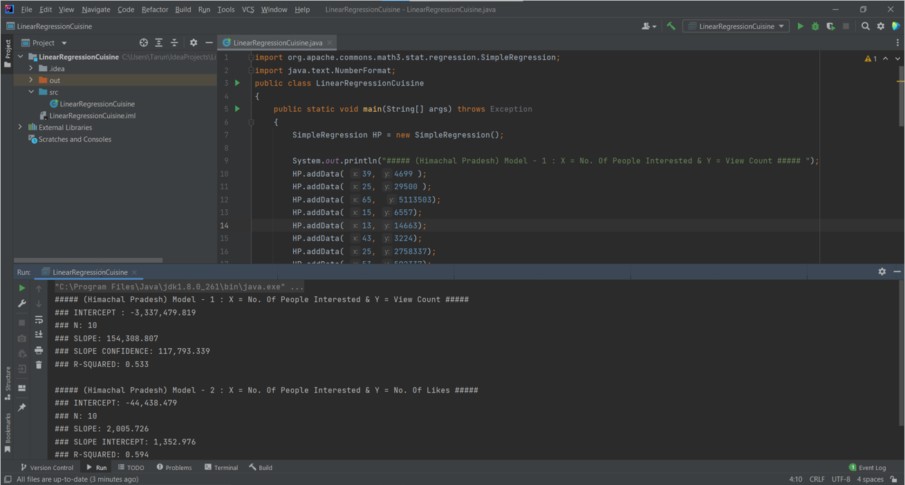

Slide 19
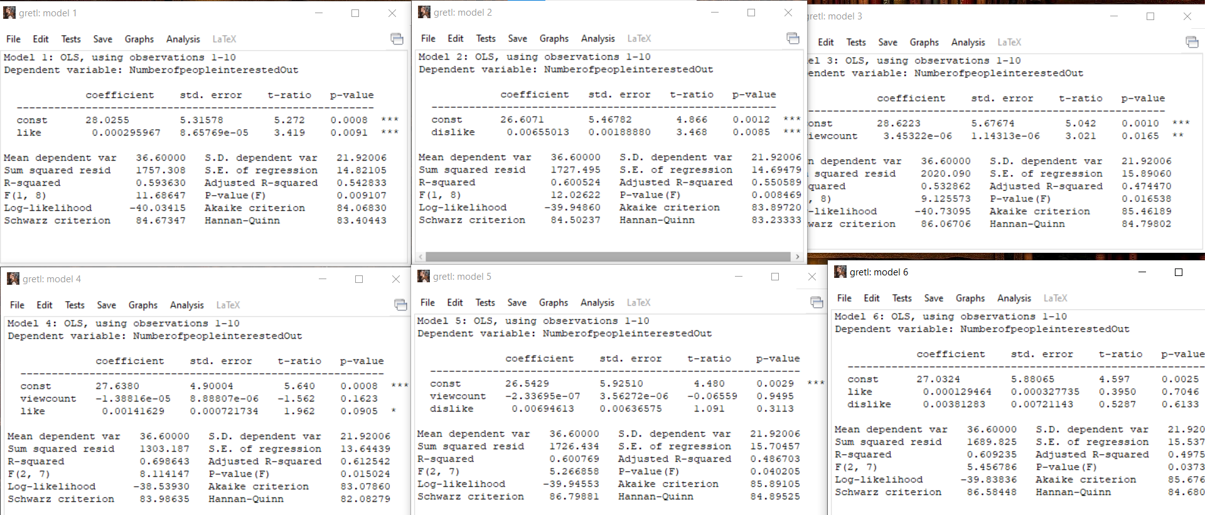
RESULT & DISCUSSION
Cuisine Of Himachal Pradesh

Slide 20
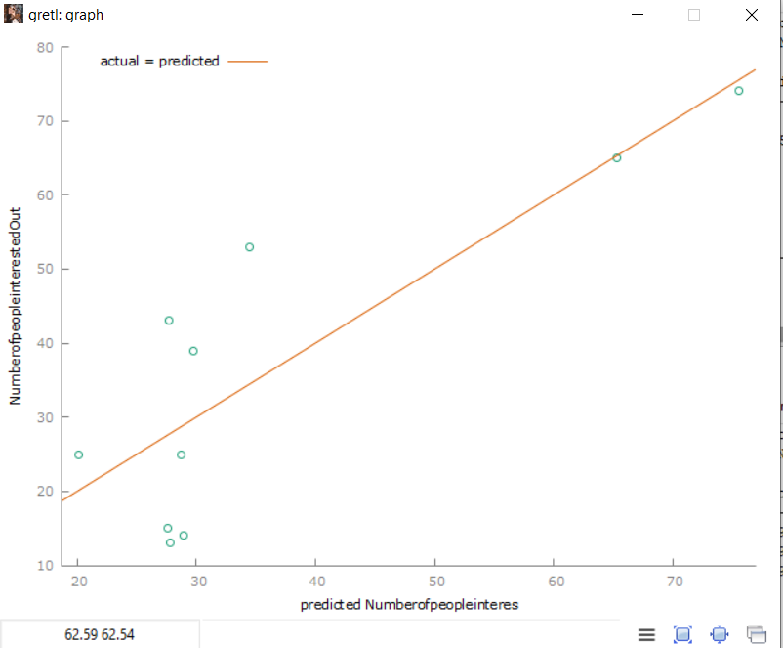
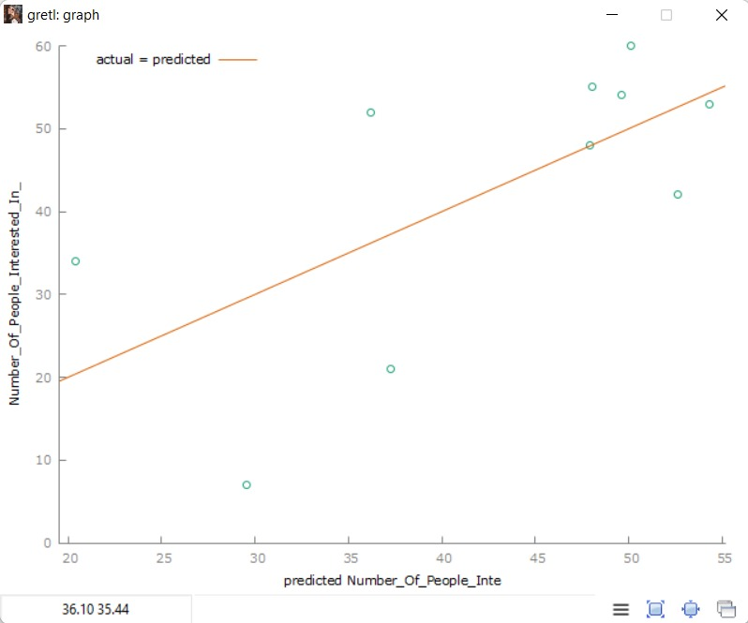
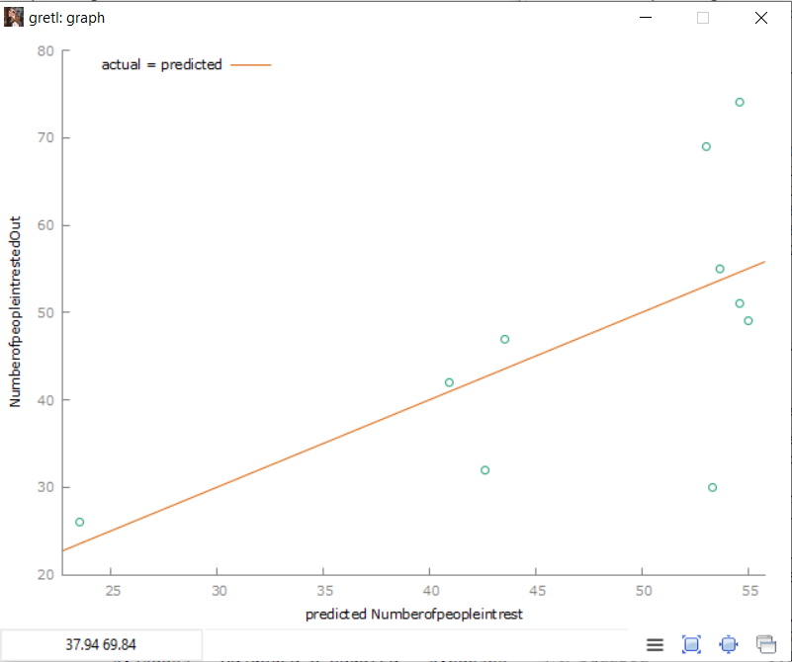
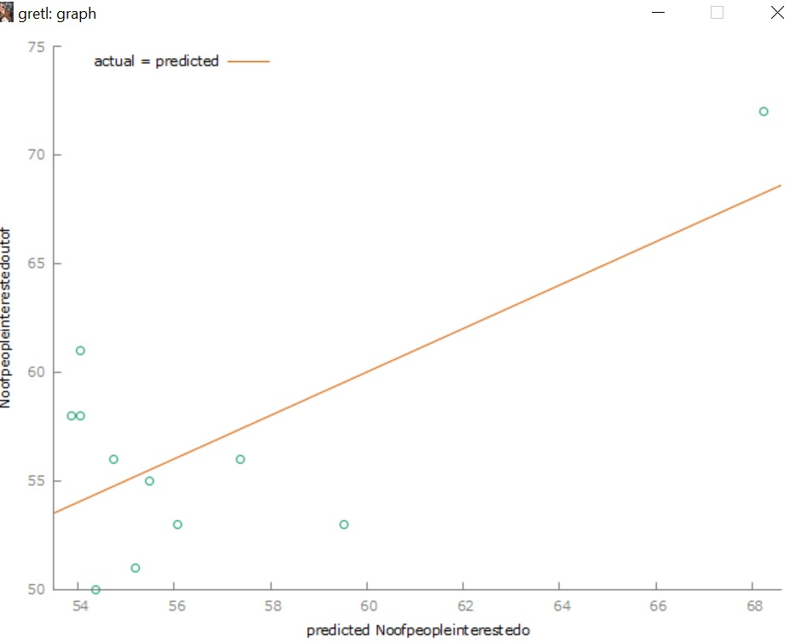
LINEAR REGRESSION GRAPH
Himachal
Pradesh
Madhya
Pradesh
Haryana
Bihar

Slide 21
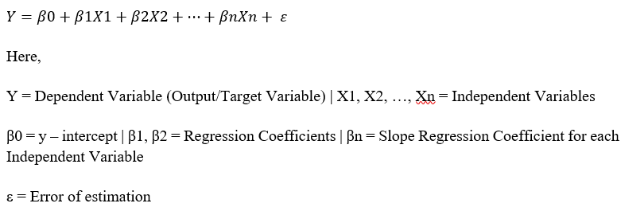
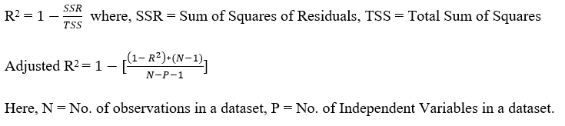
RESULT & DISCUSSION
Formula for Linear Regression:
Formula for Adjusted R-Squared:

Slide 22
APPLICATIONS & FUTURE SCOPE OF PROJECT
Tourism: Traditional foods have become an essential or key motivator in the decisions of tourists. The project will enhance the decision-making process of tourists in selection of a particular traditional dish from its local cuisine.
Cultural & Traditional Activity & Entertainment Centres: Since the global pandemic the visits to such centers have declined. Food plays a vital role in attracting tourists and adventurers to various location. These centers can target the above group of people and bring these delicious traditional cuisines to their notice.
Support to Local Vendors: The project will help local vendors’ recipes of the cuisines which are with them with ages which will get the recognition and can be perceived by the visitors and local residents.
Restaurants & Cafe Owners: The project will help various restaurants & café within the state and outside to attract large number of people to try traditional cuisines and this will also make their cuisine and recipes different from others.

Slide 23
CONCLUSION
The Mathematical model implemented in JAVA will contain a detailed statistical information of all the cuisine from different Indian States.
This data will help a lot of people to take some insights about their regional cuisine, understand reason of its decreasing popularity and make them aware about some recipes which are not much popular nowadays.
The model mainly contains statistical concepts like Linear Regression, R-Squared and Adjusted R-Squared method.
Using this mathematical model, we can promote these regional cuisine properly which are on the verge of extinction.

Slide 24
REFERENCES
Cuisine Of Haryana: https://haryanatourism.gov.in/cuisine-of-haryana#:~:text=Some%20of%20the%20famous%20dishes,Methi%20Gajjar
Questionnaire: https://forms.gle/zG8vtxnswmLnxniTA
Cuisine Of Bihar: https://www.holidify.com/pages/food-of-bihar-1643.html
Questionnaire: https://docs.google.com/forms/d/e/1FAIpQLSd9e2lAZ60TK6C2I8rriewwlG-pLjLx-o8yGrNt_lHdeLqSag/viewform
Cuisine Of Madhya Pradesh: https://www.india.com/lifestyle/top-10-foods-in-madhya-pradesh-every-foodie-must-try-1999275/
Questionnaire: https://docs.google.com/forms/d/e/1FAIpQLScbD2gU6n8M_M7G25QIySyIcXJ2CQR1h0Mv46HeyVkKA792Mw/viewform?usp=sf_link
Cuisine Of Himachal Pradesh: http://hptdc.in/index.php/cuisines/
Questionnaire: https://docs.google.com/forms/d/1Zff6hKa6YGFBre4lcVRMPHC0ZTTZM7LKhqkKp-v7MJk/edit#responses
Informative Recipe Links of various traditional cuisines with highest view count from www.youtube.com

